Slide 1

PACE:
EY
Revolutionize Claims Management:
Unleash the​ Power of GenAI for Peak Efficiency in the Insurance​ Sector​
Noorullah Khan | 47197404
Ninuri Mahagoda | 46592156
Tashiya Vilathgamuwa | 46992162
Quoc Hung Nguyen | 47578130
Aasnayem Chowdhury | 46325824

Slide 2






Team Introduction
EY/NRMA INSURANCE (CLIENT)
Data
Team
Aasnayem Chowdhury
Ninuri
Mahagoda
Tashiya Vilathgamuwa
Quoc
Nguyen
Noorullah
Khan
AI Team
Azure Solutions Architect
Project Manager / Lead Data & Software Engineer
Data Engineer & Data Modeller
Tech BA & Data Engineer
Tech BA & Data Engineer

Slide 3



Problem Statement
PROBLEM
SOLUTION
PROJECT
Lack of efficiency and accuracy resulting in increased operational costs and lengthy processing times
Fraud detection process at NRMA needs to improved using GenAI
Create an end-to-end fraud detection system using GenAI

Slide 4
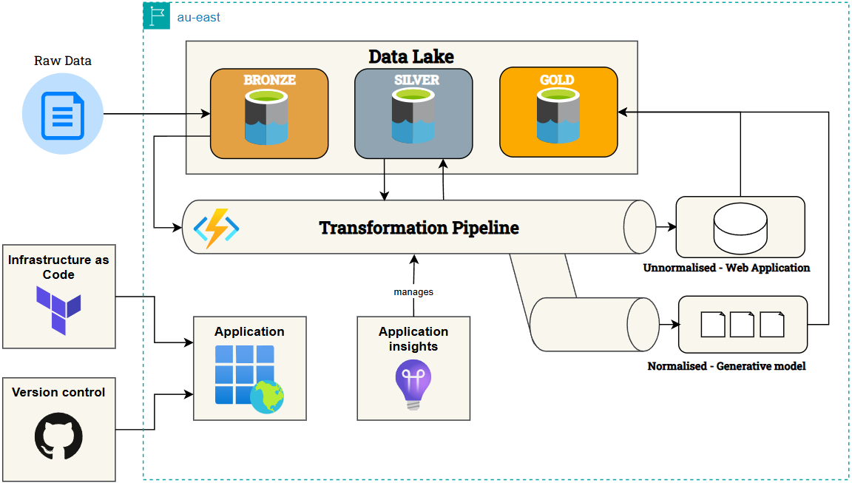
Solution
Raw Data
Unnormalised Web Application
Manages
Normalised Generative Model
Notes:
How to get to the solution
pass onto the next person

Slide 5
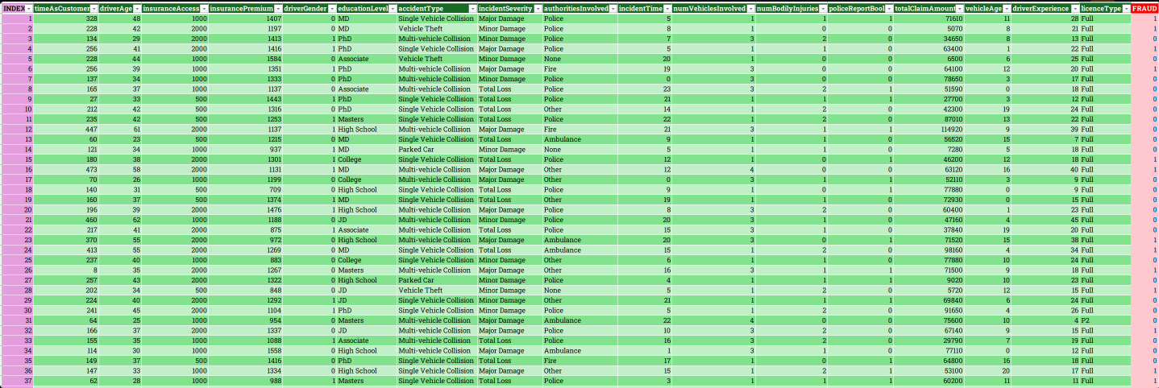
Final Dataset

Slide 6
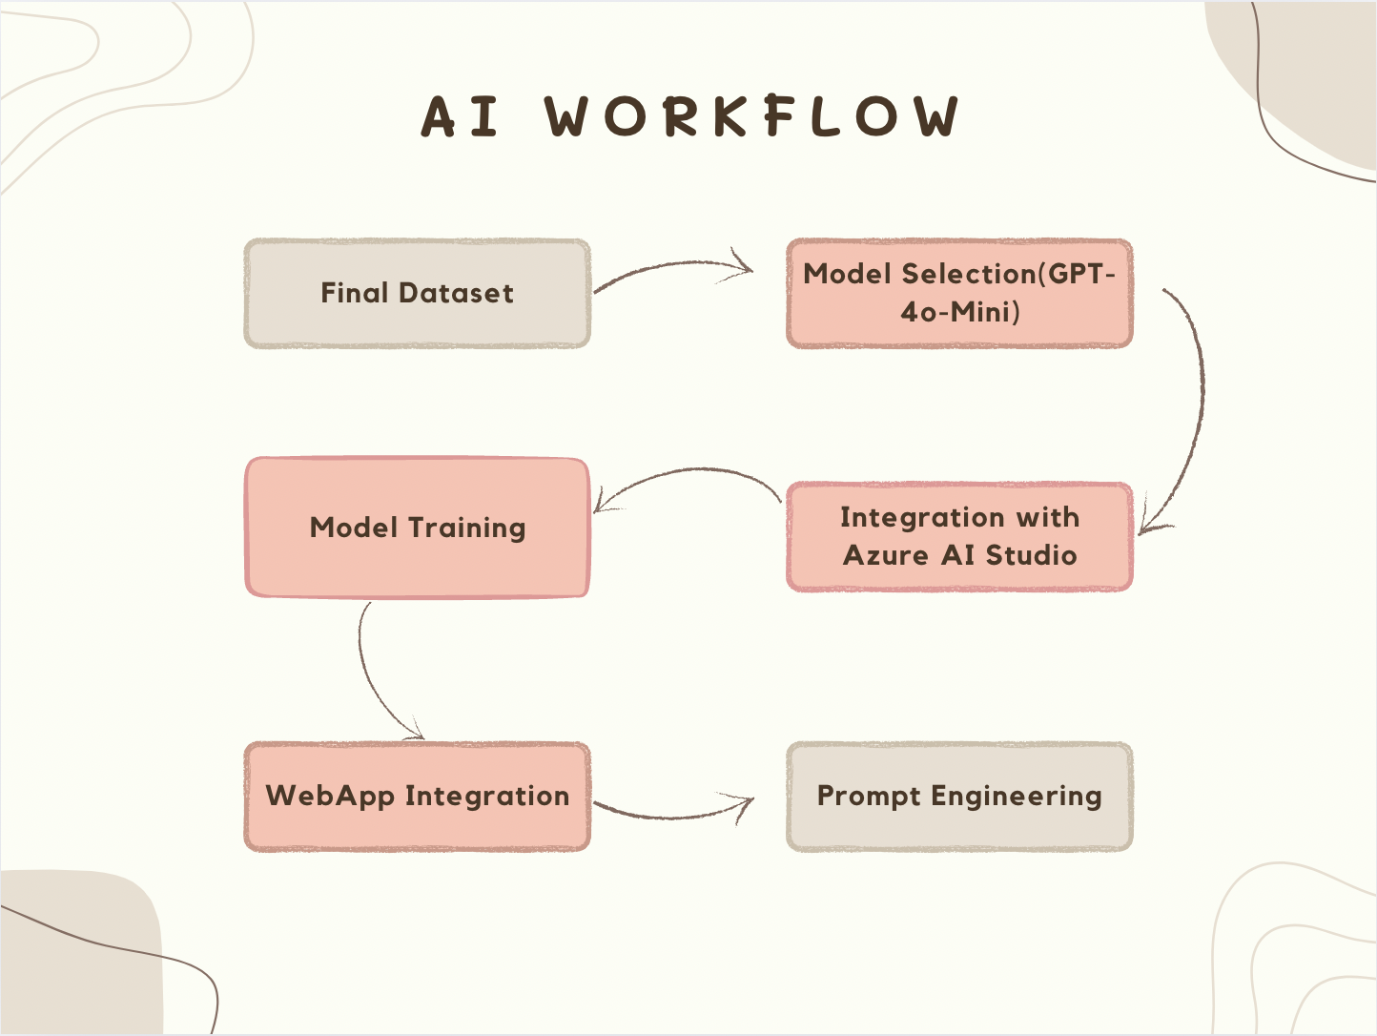
AI
Notes:
Loaded data into Azure Blob Storage
Brought OpenAI’s GPT 4o-mini Model to Azure OpenAI Studio
Prompt Engineering
Trained model using fraud data

Slide 7
01 Business Value
Cost Savings: Reduces losses from fraud, saving millions
Reputation Boost: Enhances NRMA’s position as a tech leader
Value
02 Competitive Edge
Innovation: leading the way in AI based fraud detection
Market Differentiation: Attracts clients seeking transparency
03 Empowering Claims Officers
Satisfaction: Reduces repetitive work, provides insights → enables quickers decision making.
Efficiency: AI automates screening, allowing focus on complex cases
04 Customer Experience
Quick Resolutions: With the AI model = Fast, fair claims processing builds loyalty
Loyalty: Satisfied customers promote positive word-of-mouth = enhances NRMA’s brand reputation

Slide 8
Live Demonstration
YouTube
Secure Login
Claim Management Tool
Restricted access for authorized agents only.
Add notes, update claim outcomes, and close cases seamlessly.
Dashboard Overview
User Friendly Interface
Quick view of pending and completed claims.
Simple layout with intuitive feedback and interface.
AI-Powered Fraud Detection
History & Insights
Real-time fraud risk scoring and analysis.
"Explain More" feature for detailed insights.
Ask AI feature to ask specific questions
Page to view log of all processed cases and their notes + outcomes.

Slide 9
THANK YOU FOR LISTENING!

